Slide 1
Grid Based Localization
Shubh Jaroria 2017cs10380
Shubham sondhi 2017cs10381

Slide 2
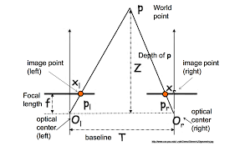
Initial Approach
Epipolar Geometry
Images from 2 cameras can be used
to detect depth of an object in 3D space
However, synchronization of the two input
streams was a problem.

Slide 3
A Grid?
A perspective grid can be achieved using only a single camera
Vanishing point analogy?
Can use homography matrix to project points from one image to other
Need corner points and corresponding points to initialize the matrix

Slide 4
Where do we get the points from?
Corner detection – accuracy wasn’t really great and we couldn’t isolate useful points
Background segmentation ?
Had to switch to manual recognition of points, required once at installation to project a grid

Slide 5
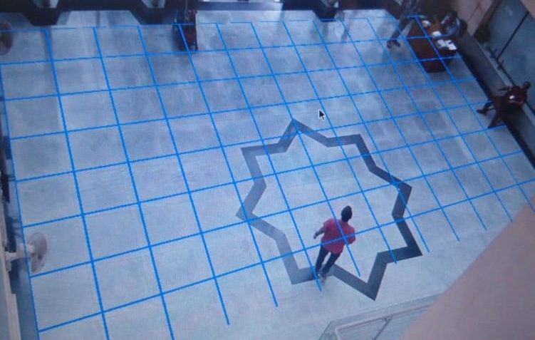

Slide 6
Detection?
Tried first with a SSD model, which was great in terms of accuracy but slow from a real-time view
Finally, we implemented detection using HOG, which gave us reasonable accuracy and a good 8-10 fps

Slide 7
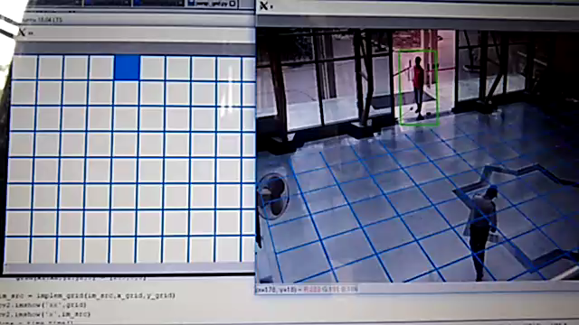

Slide 8
Tracking
We tried using the dlib library to track people, to speed up the process
Could recognize different people, but miss people in between or sometimes fail in large groups
But we had to run detection after every few frames, to detect new people that might enter, which didn’t give us the speedup we were hoping for

Slide 9
Slow video: A problem?
When we get real time input, only after the frame is processed will the next frame be captured. So there is no time lag, only processing delay
Doesn’t depend on the FPS of source stream, processing takes 6-10 FPS

Slide 10
To conclude
We were successful in localizing people indoors, but still a way out from recognizing them and labelling them as different from each other
We faced a lot of problems in areas that we didn’t even know existed, such as not being able to work with epipolar geometry at all, getting corners
Got introduced to and interested in this vast field of computer vision, with its own sea of challenges

Slide 11
Thank You

